Slide 1
CCA Finance Committee Meeting
September 24, 2025
Notes:
BOARD DECK TEMPLATE SLIDE

Slide 2
Agenda
Acknowledge Meeting Minutes from May 9, 2025
Discussion of Fiscal Performance – Financial Summary for Q2 2025
Discussion about 2024 Audit
Update on Projects/Systems

Slide 3
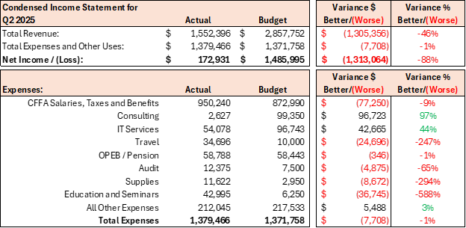
Fiscal Performance – Q2 2025
Budget comparison is based on original annual budget.
Q3 reporting will show a comparison to the revised second half forecast, presented to the board in July.
Consulting includes reclasses from Q1

Slide 4
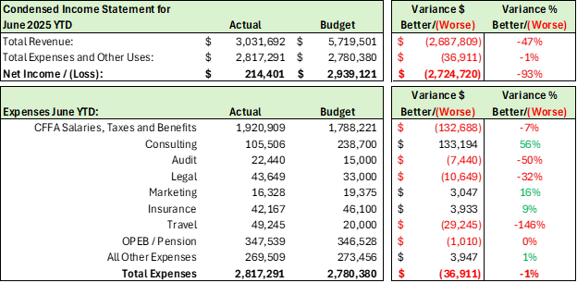
Fiscal Performance – June 2025 Year-to-Date
Salaries and Benefits overages are offset by lower consulting expenses

Slide 5
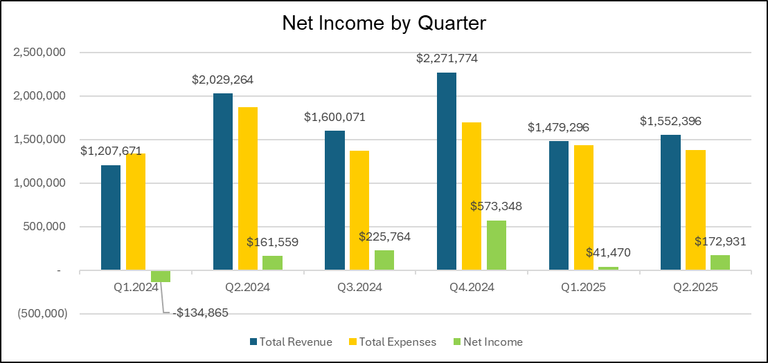
Net Income by Quarter
Q1 and Q2 Net Income, combined, are $188K more than the same quarters in the prior year

Slide 6
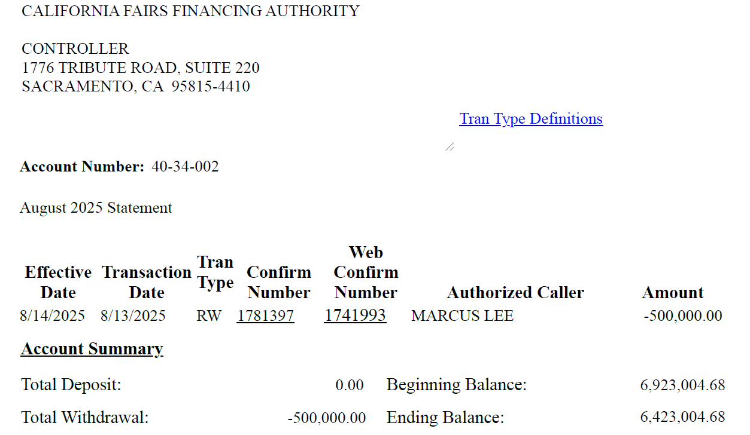
LAIF Report

Slide 7
Technology Platform Transition Update
Initial engagement with Procore proved unworkable:
High cost, lengthy timeline (≈1 year), and lack of needed features.
Alternative review identified Sage Construction Management (Sage CM) as a stronger fit:
Direct integration with Sage Intacct.
Includes required functionality and consistent support across Sage modules.
Cohesive Implementation Team
Sage CM Implementation team will be the current Sage Intacct Team
Level of support and professionalism is proven.
Substantial cost savings.
CCA has signed with Sage CM
Procore contract ends September 30, 2025, and will not be renewed.
Planned go-live: January 1, 2026.

Slide 8
Proposed California Bank of Commerce Cash Structure

Slide 9
Proposed California Bank of Commerce Cash Structure (cont.)
Combined 3-Month Interest Total: $224,779.76 + $18,196.46 = $242,976.22

