Slide 1
CCA Board Meeting
October 1, 2025
Notes:
BOARD DECK TEMPLATE SLIDE

Slide 2
Agenda Items
Resolution No. 25-16 Approving Minutes of July 16, 2025, Regular Teleconference Board Meeting
Informational Items:
  Finance Report
  Business Services Report
  Strategic Initiatives & Communications Report
  Executive Officer's Report
  Directors' Report

Slide 3
Resolution No. 25-16 – Approving Minutes of July 16, 2025,
Regular Teleconference Board Meeting
Recommendation: Approve minutes for July 16, 2025, Regular Teleconference Board Meeting

Slide 4
Informational Items
Finance Report
Notes:
BOARD DECK TEMPLATE SLIDE

Slide 5
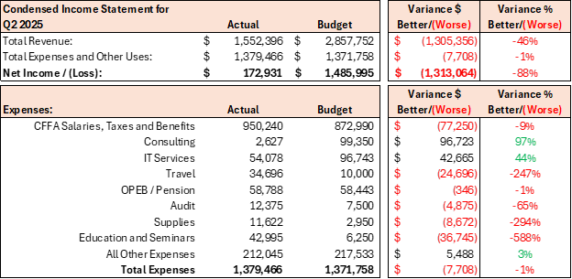
Fiscal Performance – Q2 2025
Budget comparison is based on original annual budget.
Q3 reporting will show a comparison to the revised second half forecast, presented to the board in July.
Consulting includes reclasses from Q1

Slide 6
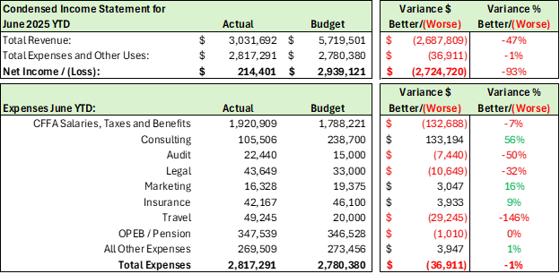
Fiscal Performance – June 2025 Year-to-Date
Salaries and Benefits overages are offset by lower consulting expenses

Slide 7
2025 Fiscal Year Reforecast
The reforecast was presented at the July 2025 Board Meeting prior to the finalization of the Q2 financials
This chart compares the original annual budget with the re-forecasted budget
The Q3 and Q4 financials will be compared against the re-forecasted budget
The largest variance is in project revenue:
  Project budgets reflected an accelerated schedule
  Project timelines were revised, with portions of revenue now projected in 2026

Slide 8
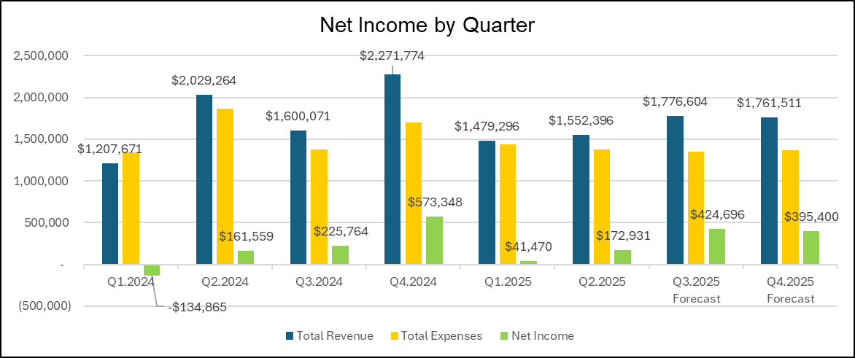
Net Income Comparison
June 2025 YTD Net Income is $188K more than June 2024 YTD Net Income
Using the 2nd half forecast for Q3 and Q4, CCA is projected to earn $1.034M in 2025 vs $0.826M in 2024

Slide 9
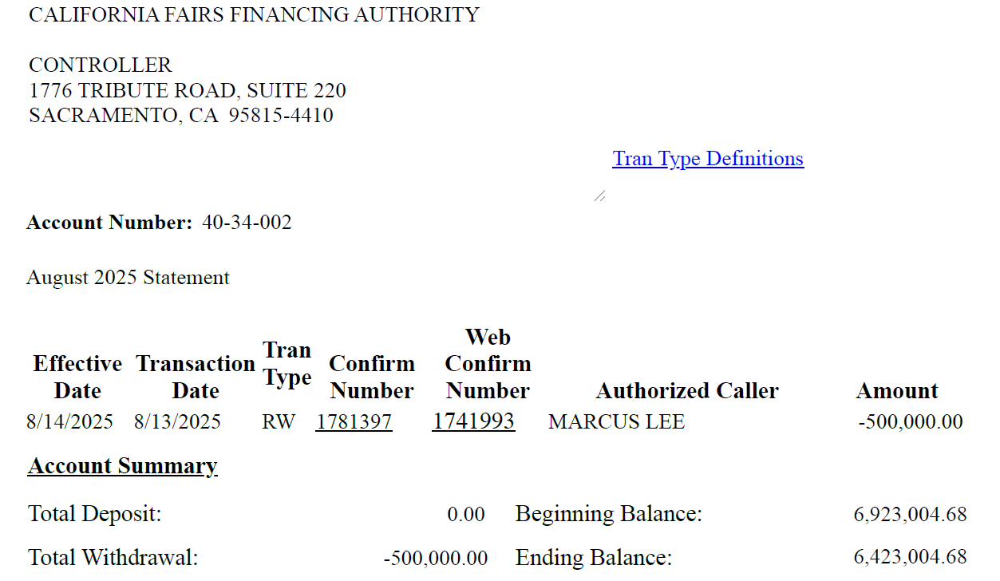
LAIF Report

Slide 10
Proposed California Bank of Commerce Cash Structure
• Funds are fully secured by Federal Home Loan Bank (FHLB)*
• CBC pledges its loan portfolio at 120% of deposit value
• FHLB reviews LOC and pledged collateral annually to ensure compliance

Slide 11
Proposed California Bank of Commerce Cash Structure (cont.)
Combined 3-Month Interest Total: $224,779.76 + $18,196.46 = $242,976.22

Slide 12
Informational Items
Business Services Report
Notes:
BOARD DECK TEMPLATE SLIDE

Slide 13
Business Services Report
Staffing Status:
Current Staffing: 22
Turnover: 0
Employee Status Breakdown:
Regular Full time: 20
Contract Employees: 2
Training:
Mandatory biennial Anti-Harassment course YTD25 Completion Rate: 100%
Supervisory Training completed for Newly Appointed Supervisors
Annual Cyber Security Training Program selected
Performance Reviews:
•New Appraisal Structure:
•SMART Goals
•Competency-Based Evaluation
•KPI Tracking
•Blended approach that weights each element of performance

Slide 14
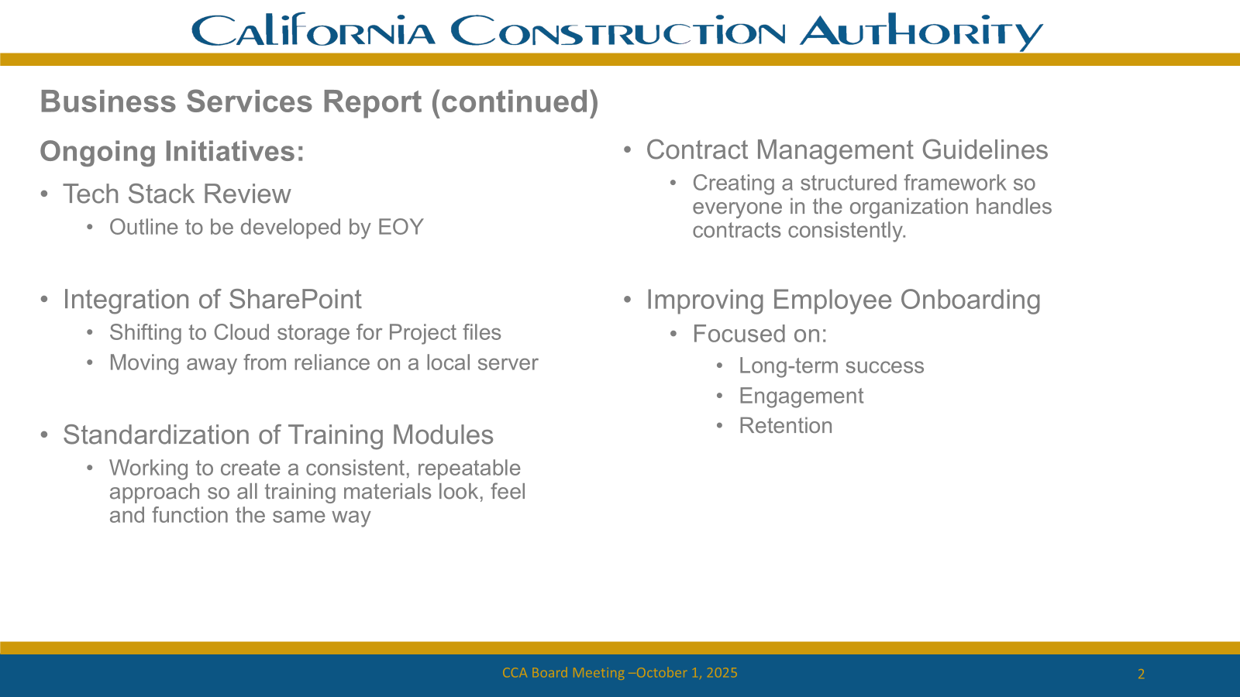
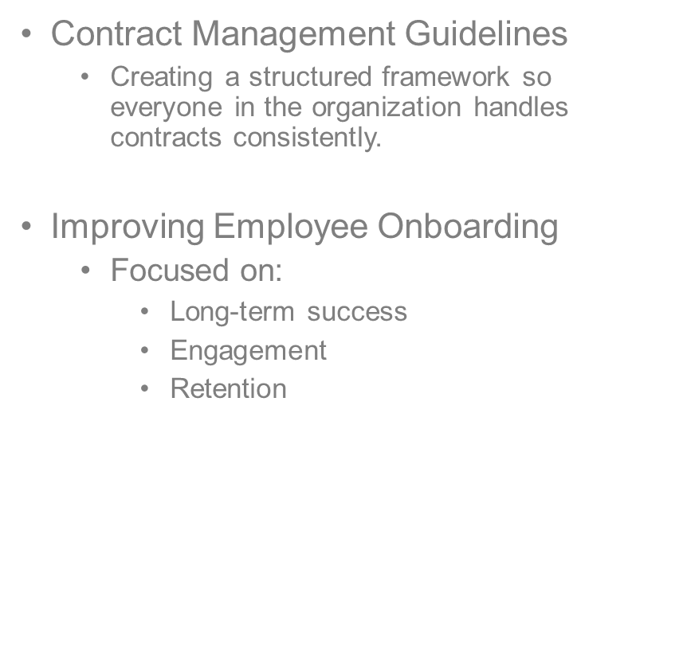
Business Services Report (continued)
Ongoing Initiatives
Tech Stack Review
  Outline to be developed by EOY
Integration of SharePoint
  Shifting to Cloud storage for Project files
  Moving away from reliance on a local server
Standardization of Training Modules
  Working to create a consistent, repeatable approach so all training materials look, feel and function the same way

Slide 15
Informational Items
Strategic Initiatives &
Communications Report
Notes:
BOARD DECK TEMPLATE SLIDE

Slide 16
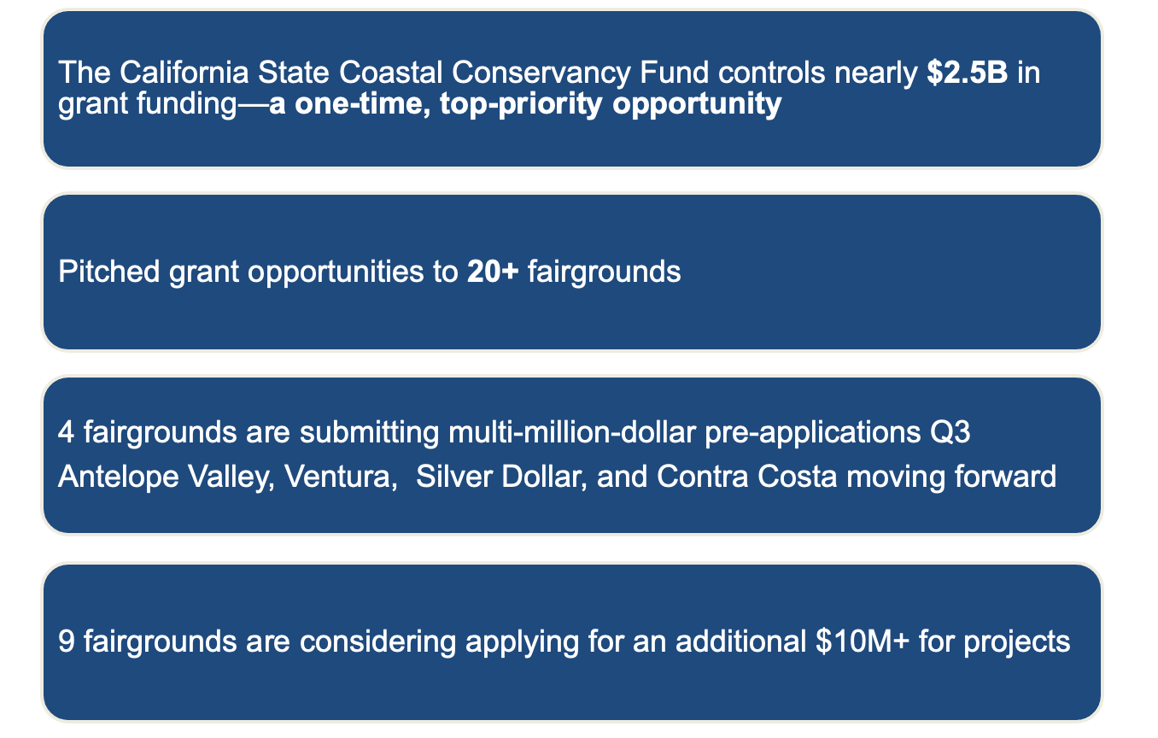
Strategic Initiatives and Communications Report: Grant Program Update

Slide 17
Overview: California State Coastal Conservancy (CSCC) Fund:
Purpose: Protects, restores, and enhances California’s coast and watersheds while expanding public access.
Key Priorities: Climate adaptation, habitat restoration, and equitable public access.
Funding Capacity: $2.5B in bond and state appropriations over the next 12–18 months.
Grant Size: Typically $500K – $5M+ per project, depending on scope and readiness.
Application Path:
– Submit a pre-application for initial review
– Upon invitation, file the full proposal.

Slide 18
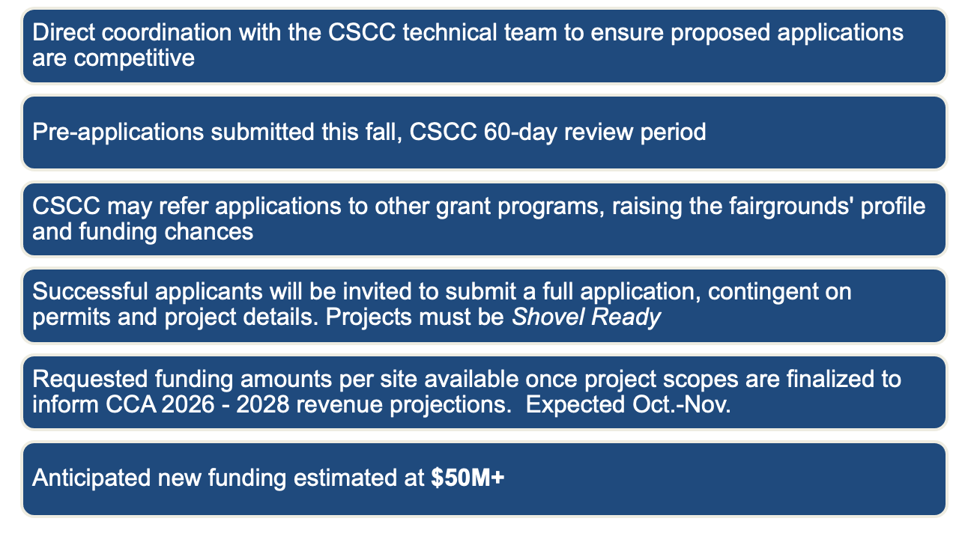
CCA & Wyn Partners Grant Services Coordination

Slide 19
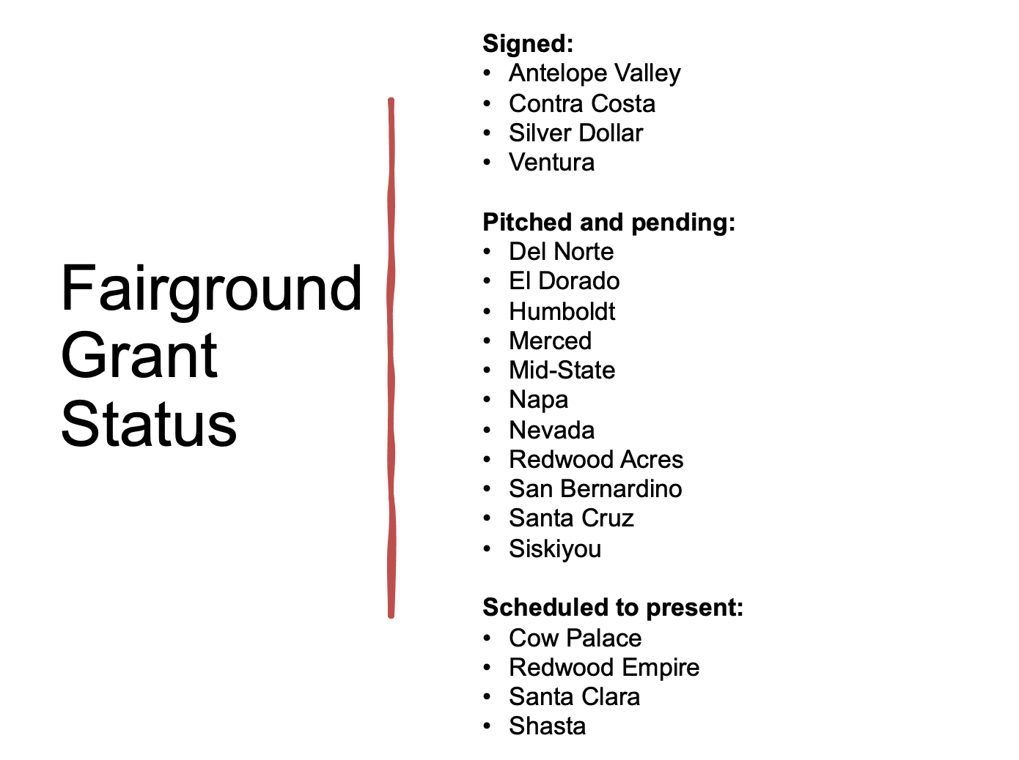
$50M+
$10M+

Slide 20
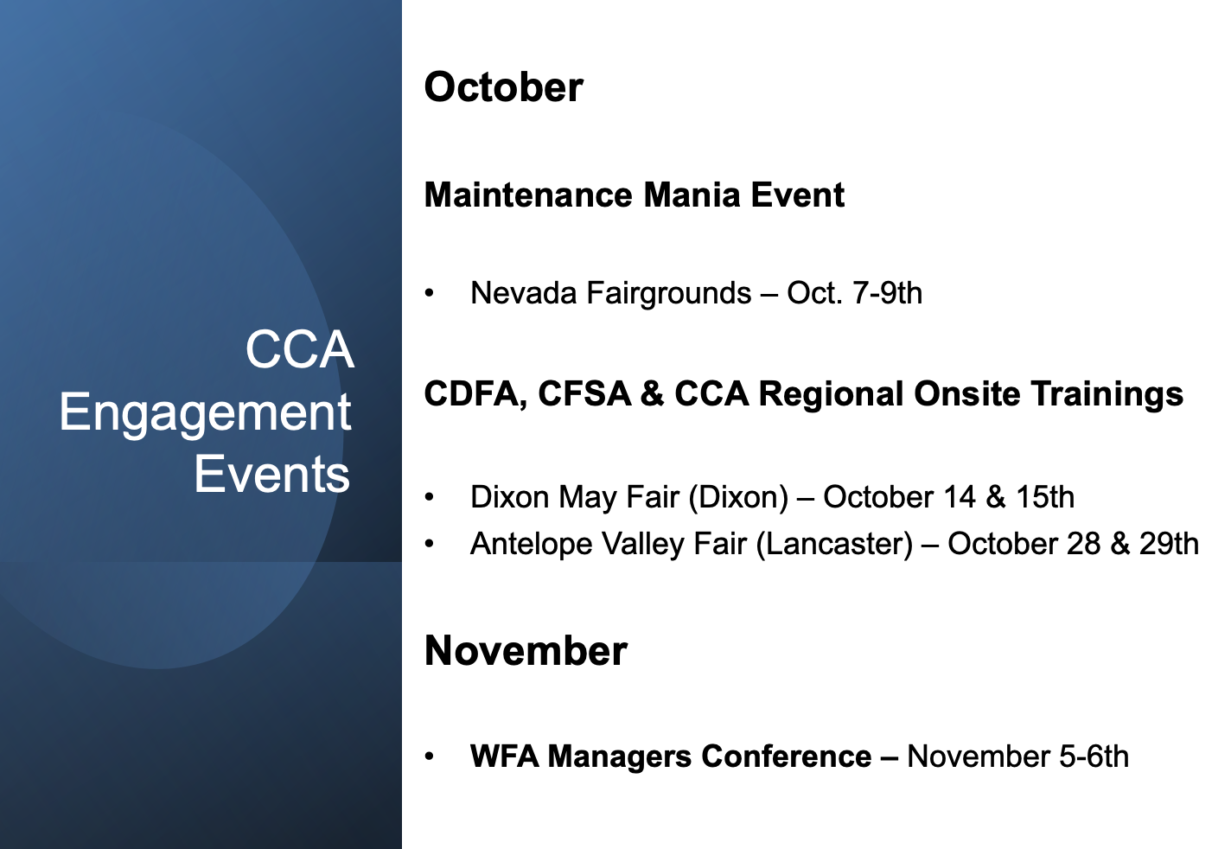

Slide 21
Informational Items:
Executive Officer’s Report
Continuing the Journey:
From Rebuilding
to Executing

Slide 22
Where We Are Now
Transitioned from rebuilding to active execution
Strengthening relationships through fairground meetings
Tightening controls on projects, budgets, and processes
Client engagement (Del Mar portfolio workshop)
Aligning project management systems – Tech Stack
Expanding pre-construction capacity through PICS
Building stronger partnerships with CDFA and SFM

Slide 23
Operational Excellence
Strengthening Business Services, Finance, and PICS teams
Implementing new accounting and project tracking systems
Aligning internal operations with client expectations
Rolling out new A/E contract templates
“Marathon” closeout: 30+ projects completed
Prioritizing FRC funding packages
Sharpening accuracy of project budget development

Slide 24
Project Focus – Construction Report
Strengthening oversight of FRC and other high-risk projects
Proactively addressing risks in budgets and schedules
Improving collaboration with SFM and AHJs
Meetings with SFM to reset and realign relationship
Strong focus on Antelope Valley MARRC
Applying lessons learned to Chico project
Tulare bids came in high but within expected range

Slide 25
Financial Stewardship
Reinforcing budget discipline (events, contracts, expenses)
Moving toward transparent project cost modeling
Reviewing fee and revenue structures for 2026 and beyond
Assessing tech stack transition to Sage CM
Completing office remodel on limited budget
Evaluating staffing needs with disciplined hiring approach

Slide 26
Client & Stakeholder Engagement
Expanding direct outreach to clients
Building trust through clear, consistent communication
Preparing rebranding and messaging campaign for 2026
Delivering consistent messaging across all fairgrounds
Emphasizing partnerships: “CCA works for YOU”
Increasing focus on triage and project study services

Slide 27
Short-Term Goals (Q4 2025 – Q1 2026)
Finalize project initiation process
Confirm refinements to CCA fee model
Solidify curated data: dashboards, KPIs, financials
Fully implement Sage CM
Develop integrated workflows for PICS
Initial training modules

Slide 28
Forward Planning
Advancing strategic framework (value proposition, 3-year plan)
October: launching 2026 business planning cycle
Expanding client categories and pipeline development
Tracking metrics: utilization, multiplier, break-even trends
Targeting new grants and funding opportunities
Building 2026 training platform
Goal: consistent, repeatable performance

Slide 29
Executing with Discipline, Building for Excellence
Operational discipline taking hold
Strengthening client relationships
Laying the foundation for sustainable performance
Delivering operational excellence
Building an aligned & enduring board relationship
Empowering employees to engage and drive progress

Slide 30
Directors' Reports
Notes:
BOARD DECK TEMPLATE SLIDE

Slide 31
2025 Board & Finance Committee Meeting Dates
Board of Directors:
  6-NOV: In Person (to be held on a Thursday after the conclusion of the WFA Manager’s Conference)
Finance Committee:
  28-OCT - Q3 2025 : Teleconference (moved from 10/29 due to scheduling conflict)

Slide 32
Regular Meeting Adjourned

