Slide 1
CCA Finance Committee Meeting
October 28, 2025
Notes:
BOARD DECK TEMPLATE SLIDE

Slide 2
Agenda
Acknowledge Meeting Minutes from September 24, 2025
Discussion of Fiscal Performance – Financial Summary for Q3 2025
FY 2024 Audit Update
Discussion about 2025 Operating Budget
Update on Sage Intacct and Sage CM
Discussion about Proposed Finance Committee Meetings for 2026

Slide 3
Fiscal Performance – Q3 2025
Comparison is based on second half re-forecasted numbers for the quarter
Revenue exceeded forecast due to projects billed in Q3 that were slated for Q4.
The Q4 forecast has been updated to reflect this revenue shift.
Supplies include non-capitalized expenses related to the office remodel

Slide 4
Fiscal Performance – September 2025 Year-to-Date
Comparison is based on second half re-forecasted numbers
Revenue exceeded forecast due to projects billed in Q3 that were slated for Q4.
Audit fees for 2023 and 2024 audits were not accrued for in the prior year

Slide 5
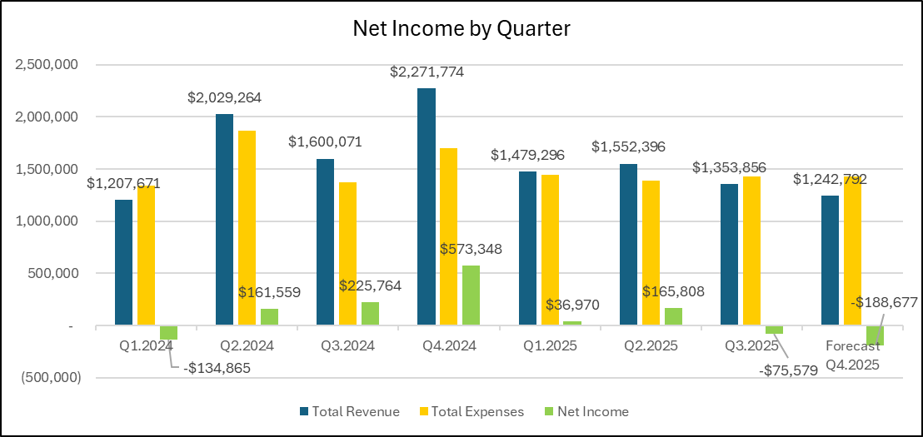
Net Income by Quarter

Slide 6
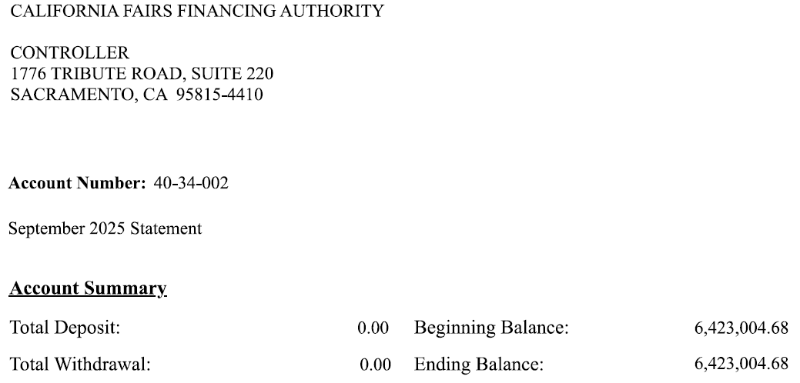
LAIF Report

Slide 7
Proposed 2026 Finance Committee Meeting Schedule
All Finance Committee meetings are planned for 10:00am

Slide 8
Questions?

